Slide 1
Docker Basics

Slide 2
Microservices
Microservices a variant of service-oriented architecture(SOA), arranges an application as a collection of loosely coupled isolated services.
Microservices is a unique method of software development that focuses on developing isolated individual services which combines as a single application.
Microservices help to build an applications as combination of multiple small services, each running in its own environment and are independently deployable.
These services can be written in different programming languages and also have its own storage and databases.
Changes done to one service will not have any downtime on other services, which also enables developers to release there changes without any dependency on other services.
Notes:
Instructor notes:
Microservices a variant of service-oriented architecture(SOA), arranges an application as a collection of loosely coupled isolated services. Microservices is a unique method of software development that focuses on developing isolated individual services which combines as a single application. Microservices help to build an applications as combination of multiple small services, each running in its own environment and are independently deployable. These services can be written in different programming languages and also have its own storage and databases.
Changes done to one service will not have any downtime on other services, which also enables developers to release there changes without any dependency on other services.

Slide 3
Microservices Advantages
Below are some of the advantages of using Microservices:
It gives developers freedom to develop and deploy services independently.
These independent services can be developed using different programming languages.
When new changes are required, it only needs to be done to specific services only instead of bring down whole application.
It provides better fault tolerance, where one service going on does not have much impact on whole application.
Notes:
Instructor notes:
Below are some of the advantages of using Microservices:
It gives developers freedom to develop and deploy services independently.
These independent services can be developed using different programming languages.
When new changes are required, it only needs to be done to specific services only instead of bring down whole application.
It provides better fault tolerance, where one service going on does not have much impact on whole application.

Slide 4
Microservices Disadvantages
Below are some of the disadvantages of using Microservices:
Due to multiple services, it becomes sometimes complicated to perform end to end testing.
Developers need to put additional efforts to establish connectivity between multiple services.
With multiple services utilization of resources would also increase.
Debugging errors for services can be harder since each service has its own service logs.
Notes:
Instructor notes:
Below are some of the disadvantages of using Microservices:
Due to multiple services, it becomes sometimes complicated to perform end to end testing.
Developers need to put additional efforts to establish connectivity between multiple services.
With multiple services utilization of resources would also increase.
Debugging errors for services can be harder since each service has its own service logs.

Slide 5
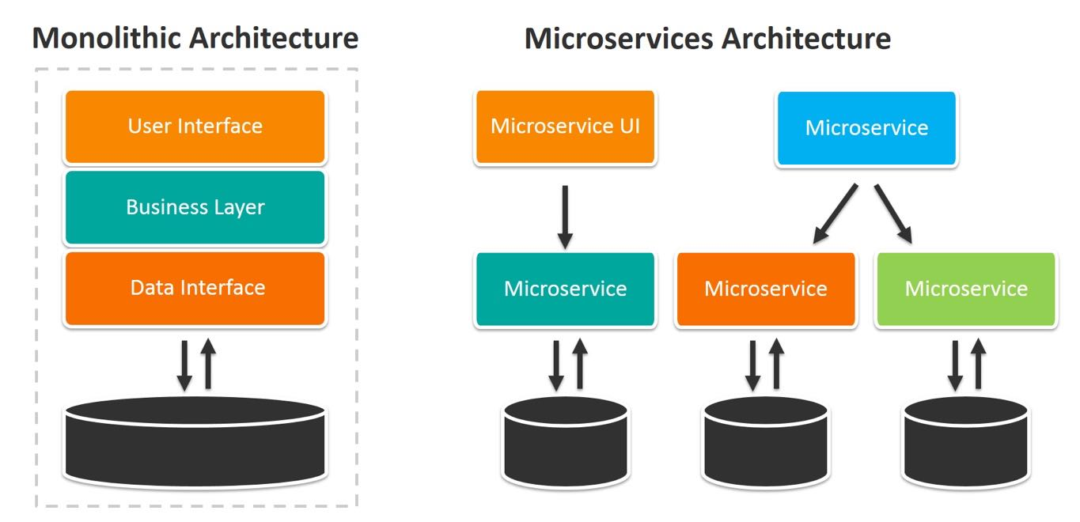
Microservices Architecture
Source: Rancher
Notes:
Instructor notes:
This diagram shows what is the fundamental difference between monolithic and microservice architecture, where we spit big monolithic application into smaller micro services which can be deployed individually. These services can have their own separate data sources also which also makes database smaller in size.

Slide 6
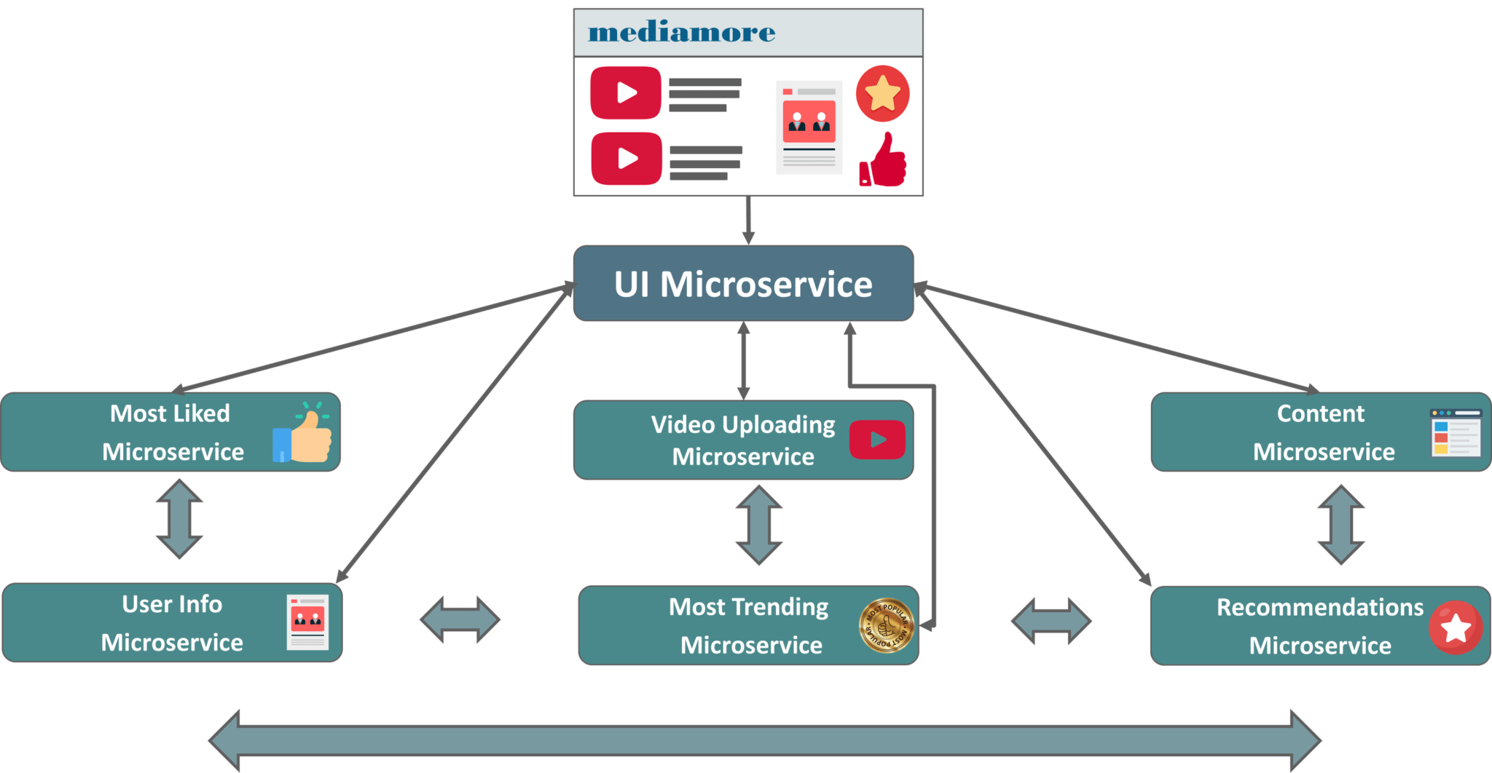
Microservices Architecture
Notes:
Instructor notes:
This diagram shows what is the fundamental difference between monolithic and microservice architecture, where we spit big monolithic application into smaller micro services which can be deployed individually. These services can have their own separate data sources also which also makes database smaller in size.

Slide 7
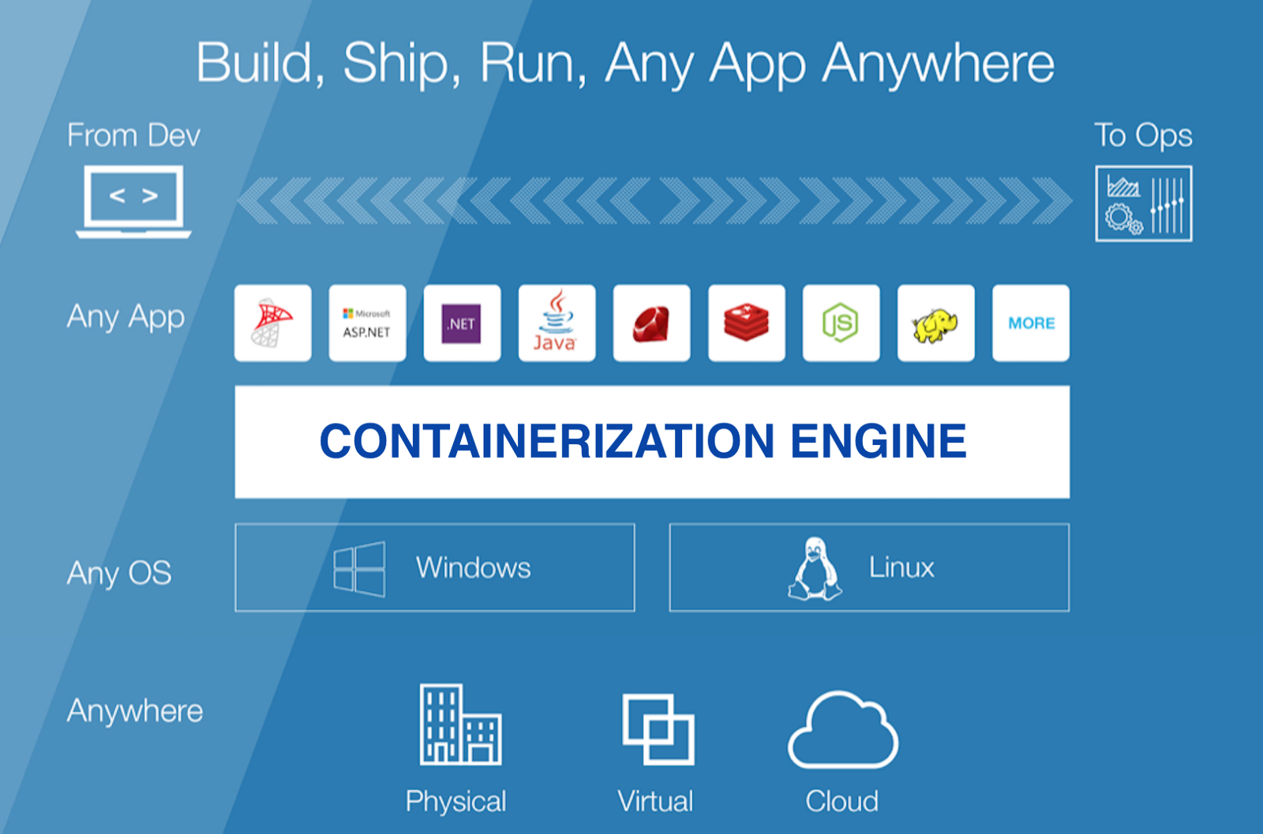
Containerization
Source: HackerNoon
Notes:
Instructor notes:
Containerization is defined as a form of operating system virtualization, through which applications are run in isolated user spaces called containers, all using the same shared operating system (OS). Containerization involves bundling an application together with all of its related configuration files, libraries and dependencies required for it

Slide 8
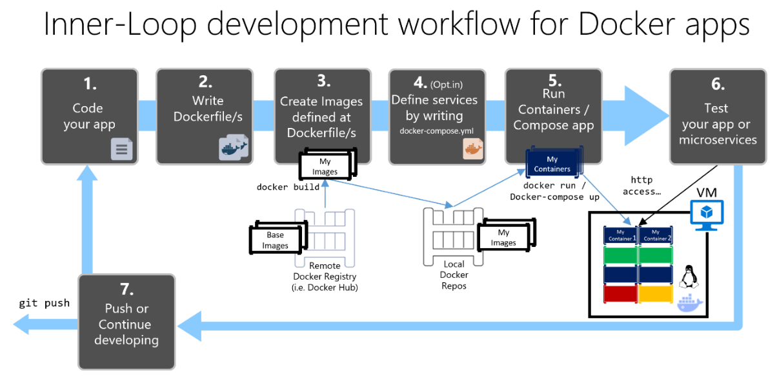
Containerization Pipeline
Notes:
Instructor notes:
Containerization is defined as a form of operating system virtualization, through which applications are run in isolated user spaces called containers, all using the same shared operating system (OS). Containerization involves bundling an application together with all of its related configuration files, libraries and dependencies required for it

Slide 9
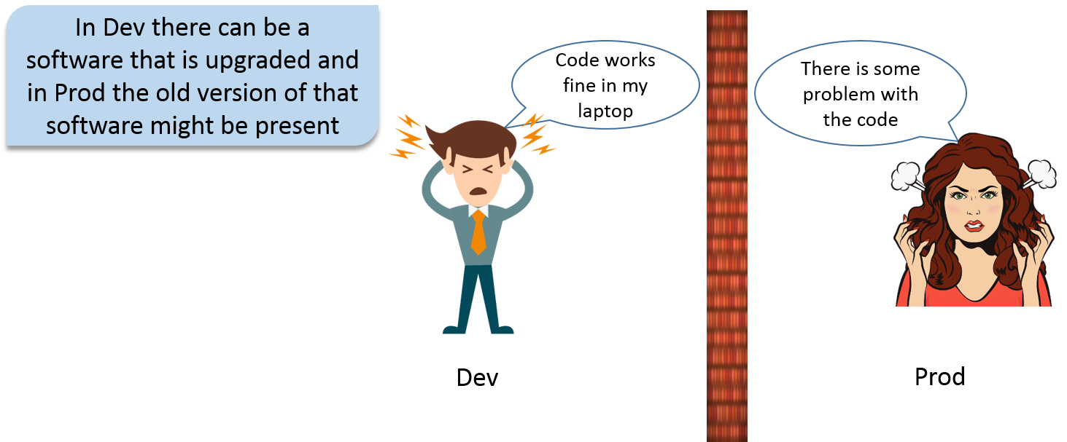
Need of Docker - Versioning Problem
Source: Quora
Notes:
Instructor notes:
Most of time while working with software applications we face versioning problem for dependencies on server.
Code works fine in one environment but does not work in another version.

Slide 10
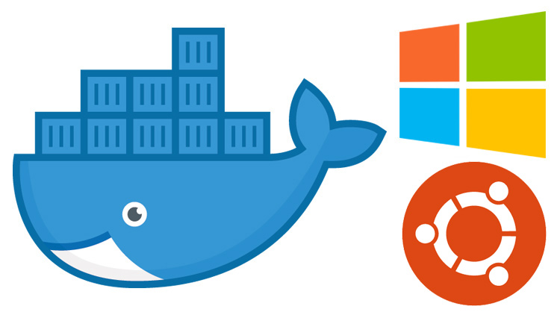
Need of Docker - Versioning Problem
Notes:
Instructor notes:
This problem can be resolved with help of docker where we don’t need to worry about dependencies version across Different environment. We can host our application on multiple environments without managing dependencies
On host machine.

Slide 11
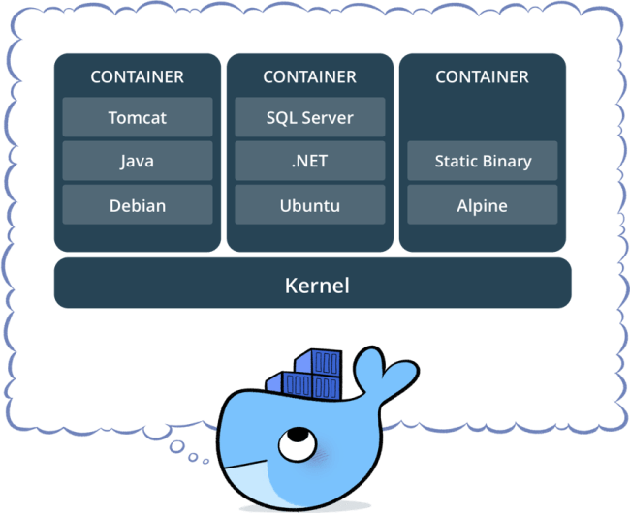
Why to use Docker?
Notes:
Instructor notes:
Docker has multiple benefits and some of them are listed below:
Built on one machine and run everywhere: With docker we can built up docker images locally and then same docker image can be deployed across multiple machines.
Easy configuration: Docker supports easy configuration which helps developers to reduce manual configurations steps.
Faster delivery cycles: Docker containers make its easy to deploy new applications and releases latest version to business.
Application portability: Docker containers are portable which means we can deploy and run them on any docker host whether its windows or Linux.
Easy Deployments: Docker containers are easy to deploy across multiple environments and these can be easily deployed using Jenkins pipeline scripts.
Application testing with new versions: We can use latest version of dependencies to test application source code. We can simply use latest docker image and test application without performing much of installation process.

Slide 12
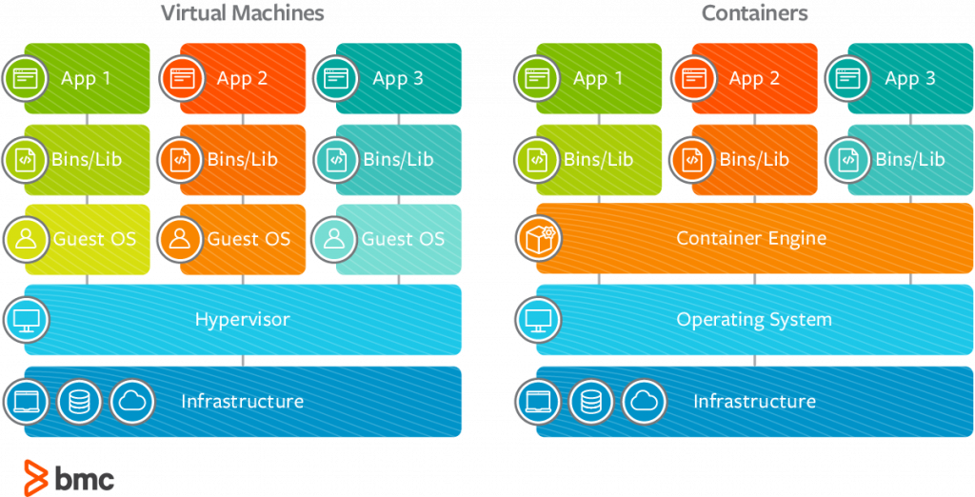
Why to use Docker?
Notes:
Instructor notes:
Docker has multiple benefits and some of them are listed below:
Built on one machine and run everywhere: With docker we can built up docker images locally and then same docker image can be deployed across multiple machines.
Easy configuration: Docker supports easy configuration which helps developers to reduce manual configurations steps.
Faster delivery cycles: Docker containers make its easy to deploy new applications and releases latest version to business.
Application portability: Docker containers are portable which means we can deploy and run them on any docker host whether its windows or Linux.
Easy Deployments: Docker containers are easy to deploy across multiple environments and these can be easily deployed using Jenkins pipeline scripts.
Application testing with new versions: We can use latest version of dependencies to test application source code. We can simply use latest docker image and test application without performing much of installation process.

Slide 13
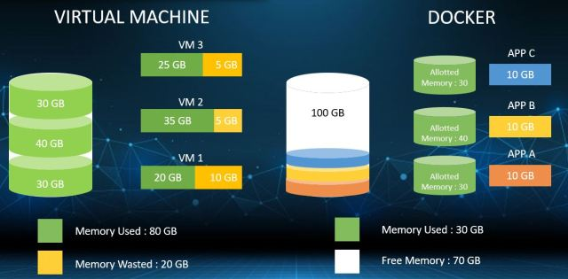
Why to use Docker?
Notes:
Instructor notes:
Docker has multiple benefits and some of them are listed below:
Built on one machine and run everywhere: With docker we can built up docker images locally and then same docker image can be deployed across multiple machines.
Easy configuration: Docker supports easy configuration which helps developers to reduce manual configurations steps.
Faster delivery cycles: Docker containers make its easy to deploy new applications and releases latest version to business.
Application portability: Docker containers are portable which means we can deploy and run them on any docker host whether its windows or Linux.
Easy Deployments: Docker containers are easy to deploy across multiple environments and these can be easily deployed using Jenkins pipeline scripts.
Application testing with new versions: We can use latest version of dependencies to test application source code. We can simply use latest docker image and test application without performing much of installation process.

Slide 14
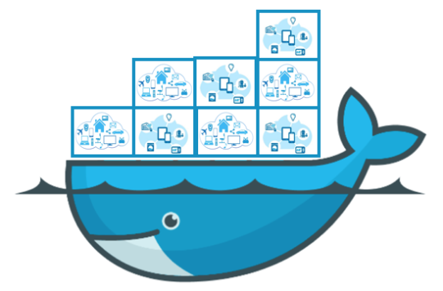
What is Docker ?
Notes:
Instructor notes:
Docker is an open source software used to automate deployment of software applications inside docker container. It provides abstraction and automation of OS-level virtualization.
Docker allows developers, admins to deploy software applications easily within containers and run them on any Linux or Windows host. Using docker users can package both software and dependencies inside docker container in a standard process.

Slide 15
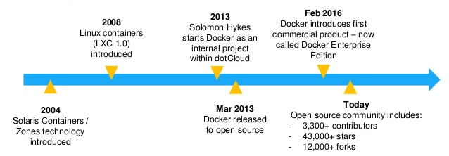
Docker History
Notes:
Instructor notes:
In 2004 Solaris Containers / Zones technology was introduced and we were having our first option to create containers.
In year 2008 Linux containers(LXC 1.0) was introduced. It was better than solaris containers but still lot of limitations were there.
In 2013 Solomon Hykes starts Docker as an internal project within dotCloud. He launched Docker first version as open source.
In Feb 2016, docker introduces first official commercial product known as Docker Enterprise Edition.

Slide 16
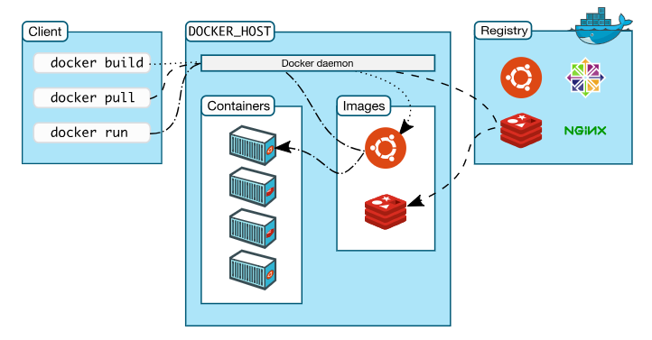
Docker Architecture
Source: Docker
Notes:
Instructor notes:
Docker uses a client-server architecture. Docker daemon is core component which performs all tasks like building, running and sharing docker containers.
Docker client and daemon gets configured on same machine, so that client can interact with docker daemon. We can even connect to a remote docker daemon also with docker client. Docker client uses REST API to communicate with docker daemon.

Slide 17
Docker Features
Below are some of benefits which we get when we implement docker
01
Easy and Faster Configuration
02
Increase productivity
03
Application Isolation
04
Routing Mesh
05
Services
Notes:
Instructor notes:
Below are some of benefits which we get when we implement docker:
Easy and Faster Configuration: This is one of important feature of docker that it provides each configuration mechanism for software applications. We can host our applications in less time and efforts. We can create multiple environment for single application without creating multiple servers.
Increase productivity: Docker also increases productivity by providing easy configuration and fast deployments. It also helps us to reduce the resource consumption for hosting multiple applications.
Application Isolation: Docker support total isolated environment without any interference. Each application deployed inside containers will be isolated with each other and will not have any impact on each other.
Routing Mesh: It helps to route incoming traffic with on host ports to docker containers to access applications. With this we can host same applications multiple times with different ports and URL’s.
Services: Services lets users to expose containers so that we can access applications from outside containers also. Each task created in services represent one containers deployed on a cluster.

Slide 18

Docker Components
Below are some of components of docker architecture:
The Docker daemon
The Docker Client
Docker Registries
Docker Images
Docker Containers
Source: Docker
Notes:
Instructor notes:
The Docker daemon: The Docker daemon (dockerd) accepts API requests from docker client and performs various operations on Docker host. Some of the objects managed by Docker daemon are such as docker images, docker containers, docker volumes, docker networks. Daemon should be always up and running in case we want our docker containers alive on server.
The Docker client: Docker client is used by users to interact with docker daemon. Docker client will send all requests through API interface to docker daemon. Docker client can also be used to manage docker images and containers on host.
Docker registries: Docker registry is used to host docker images. These docker images can be stored either privately or publicly on docker host. Docker hub is free cloud service where we can host both public and private docker image.
Docker Images: Docker image is a read only template that have some instructions code inside it. User uses docker images to create docker containers which will be further used to host applications inside them.
Docker Containers: Docker container is a instance of docker image. You can create, start, stop or remove docker container using docker client.

Slide 19
Docker Image
Docker image is a read-only template with instructions for creating a Docker container.
An image is a combination of a file system, binaries and network configurations.
An image is an inert, immutable, file that's essentially a snapshot of a container.
We can use ready made images or custom images to create docker containers using docker run command.
Docker images can be stored on Docker Hub, ECR or any artifactory docker repository.
Notes:
Instructor notes:
Docker image acts like a source which is used to create Docker containers. Without docker image we can not create docker containers. We can create custom docker image bundled with both dependencies and application source code. These custom docker images will be pushed to docker repository and same can be downloaded or pulled on destination server.
Since they can become quite large, images are designed to be composed of layers of other images, allowing a minimal amount of data to be sent when transferring images over the network.
In case we don’t have network connectivity we can export docker images from one machine to another.

Slide 20
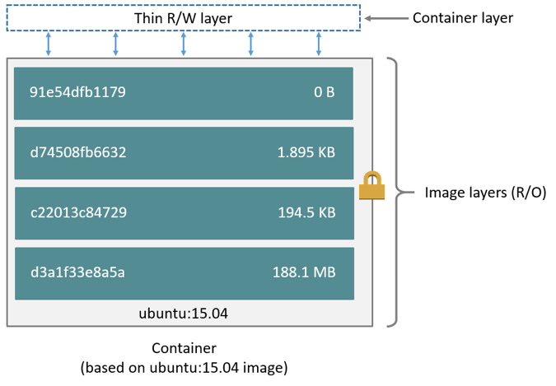
Docker Image
Notes:
Instructor notes:
In above diagram we could see layered architecture of ubuntu docker image. In this we could see all different layers in final ubuntu docker image. These layers are read only template which we can not modify, but we can add new layer on top of existing layers.
We can download database, web servers, base operating system docker images for free from docker hub or any docker repository.

Slide 21
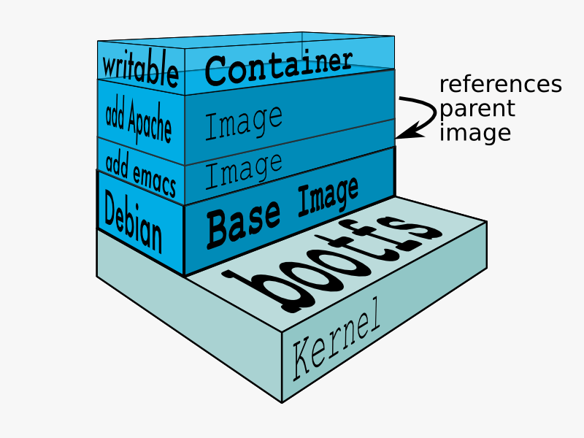
Docker Custom Image
Notes:
Instructor notes:
Docker Base image is the basic image, on top of which we add more and more layers consisting of applications and software’s. Usually these base images are also called as OS base image e.g. Ubuntu, centos, fedora, Debian etc.
Size of these base images are quiet small as compared to actually OS. Typical size can be approx. 200MB. We can prepare custom Docker images also using one these base OS Docker images.
docker pull <base image name>:<tag> Command to pull base OS image

Slide 22
Docker Image Commands
Docker Engine uses below mentioned commands to manage docker images on server:
docker images
docker run
docker tag
docker pull
docker push
docker commit
docker rmi
Notes:
Instructor notes:
Docker Engine uses below mentioned commands to manage docker images on server:
docker images: List all local images.
docker run: Create a container from an image and execute a command in it.
docker tag: Tag an image.
docker pull: Download image from repository.
docker push: Upload image to repository from local system.
docker commit: Create a new image from a container’s changes.
docker rmi: Delete a local image and this will also remove intermediate images if no longer used.

Slide 23
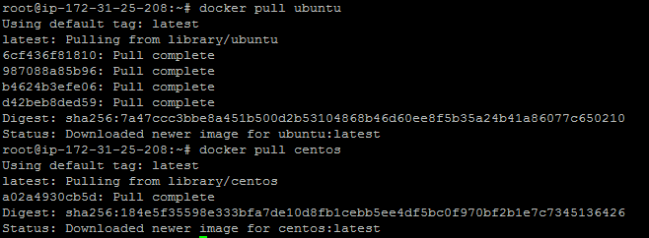
Docker Base Image
Notes:
Instructor notes:
Docker Base image is the basic image, on top of which we add more and more layers consisting of applications and software’s. Usually these base images are also called as OS base image e.g. Ubuntu, centos, fedora, Debian etc. Size of these base images are quiet small as compared to actually OS. Typical size can be approx. 200MB.
We can prepare custom Docker images also using one these base OS Docker images.
docker pull <base image name>:<tag> Command to pull base OS image
Most of application docker images are prepared using some base docker image using Dockerfile. Developers also deploy package dependencies and application source code on top of base docker images.

Slide 24
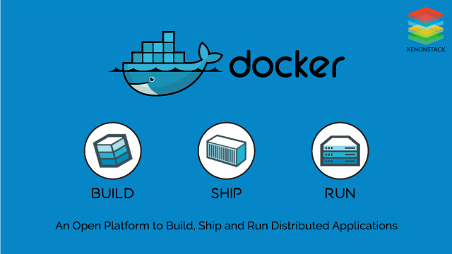
Docker Containers
Source: Docker
Notes:
Instructor notes:
Container is a instance of docker image which gets created once we execute docker run command. A container is a standard unit of software that packages up code and all its dependencies.
We can easily use same docker image multiple times on different machines. We can initialize container both in interactive and detached mode.
Containers isolate software from its environment and ensure that it works uniformly despite differences for instance between development and staging.

Slide 25
Docker Registry
Docker registry is an application which stores and deliver docker images.
As part of CI CD pipelines once docker images are built up, we can store them on Docker registry.
We have various application providing Docker registries such as docker hub, ECR, Jfrog artifactory etc.
By default we can use free docker registry called Docker hub, where all application based docker images are available to download.
Notes:
Instructor notes:
Docker registries are available both as private and public, depending on which registry application we are using. Docker hub is one of free public repository which any one can use to push docker images. We also have option to push docker image privately on Docker hub with enterprise license.
All base OS images and custom software's images are available in Docker hub and we can easily pull those on any server.

Slide 26
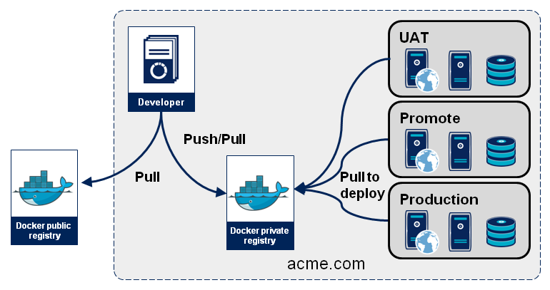
Docker Registry
Source: octo
Notes:
Instructor notes:
In above diagram we could see both push and pull operations on docker image. We can interact with multiple docker registries. We can use docker push command to push images from docker host to registry. Below is the command sequence:
docker tag local-image:tagname reponame:tagname
docker push reponame:tagname

Slide 27
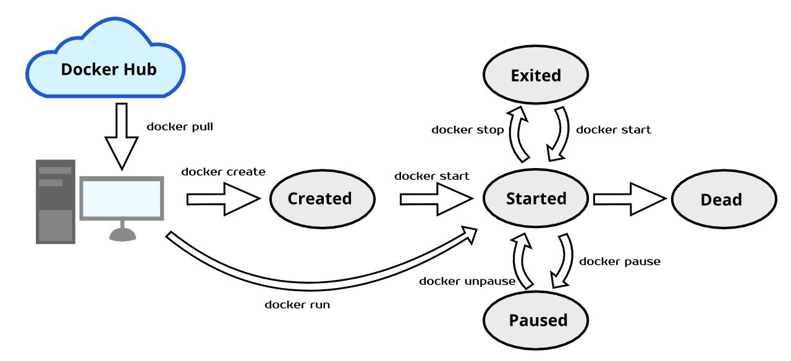
Docker Container Lifecycle
Source: Medium
Notes:
Instructor notes:
Above lifecycle shows various stages of a Docker container:
Create container: Create a container to run it later on with required image.
docker create --name <container-name> <image-name>
Run docker container: Run the docker container with the required image and specified command / process. ‘-d’ flag is used for running the container in background.
docker run -it -d --name <container-name> <image-name> bash
Pause container: Used to pause the processes running inside the container.
docker pause <container-id/name>
Unpause container: Used to unpause the processes inside the container.
docker unpause <container-id/name>
Start container: Start the container, if present in stopped state.
docker start <container-id/name>
Stop container: To stop the container and processes running inside the container:
docker stop <container-id/name>
Restart container: It is used to restart the container as well as processes running inside the container.
docker restart <container-id/name>
Kill container: We can kill the running container.
docker kill <container-id/name>
Destroy container Its preferred to destroy container, only if present in stopped state instead of forcefully destroying the running container.
docker rm <container-id/name>

Slide 28
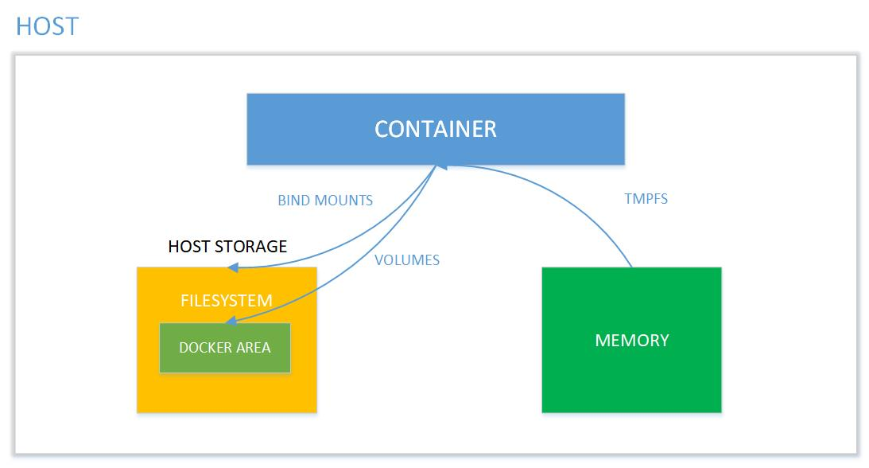
Filesystem in Containers
Source: Binary Maps
Notes:
Instructor notes:
When we work with docker container, if we removes container data doesn’t persist on server and we will be not be able to access that data. A container’s writable layer is tightly coupled to the host machine where the container is running.
We need storage driver to do modifications to this writable layer of docker container. The storage driver controls how images and containers are stored and managed on your Docker host.

Slide 29
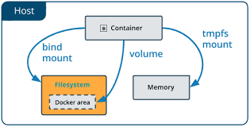
Bind Mounts Docker
Notes:
Instructor notes:
Bind mounts have been around since the early days of Docker. Bind mounts have limited functionality compared to volumes. When you use a bind mount, a file or directory on the host machine is mounted into a container.
Bind mounts can be easily mounted across multiple containers which is the limitation with Docker volumes.

Slide 30
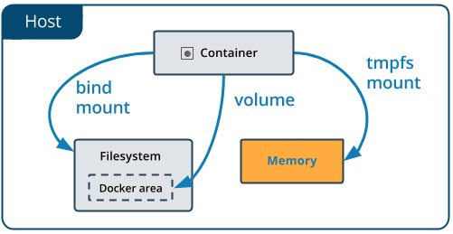
Tmpfs Docker
Notes:
Instructor notes:
When you create a container with a tmpfs mount, the container can create files outside the container’s writable layer. tmpfs mount is temporary, and only persisted in the host memory. When the container stops, the tmpfs mount is removed, and files written there won’t be persisted.

Slide 31
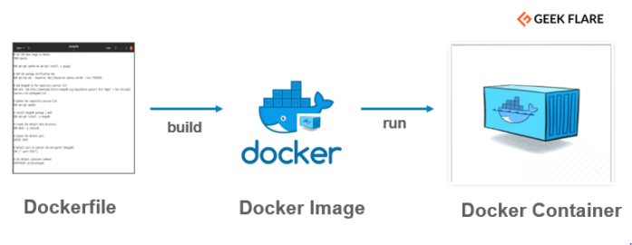
Dockerfile
Notes:
Instructor notes:
Dockerfile is a build script having series of instructions used to build Docker images automatically. We can version these build script with source code in Git repositories.
These scripts are used to automate the Docker CI/CD workflow in Jenkins. We can automate the whole process of bundling applications with dependencies using Dockerfile. Docker build command is used to build Docker images. Below is the syntax for Docker build:
docker build -t <image name>:<tag>
Example:
FROM ubuntu ENV DOCK_MESSAGE Hello My World ADD dir /files CMD ["bash", "someScript"]

Slide 32
Creating Dockerfile
In order to create Dockerfile, we need to create a new working directory where we will run docker build.
Follow below commands to create Dockerfile for docker image build.
mkdir dockerbuild
cd dockerbuild
Now we will create Dockerfile in build directory:
nano Dockerfile
Notes:
Instructor notes:
In order to create Dockerfile, we need to create a new working directory where we will run docker build. Follow below commands to create Dockerfile for docker image build.
mkdir dockerbuild && cd dockerbuild
Now we will create Dockerfile in build directory:
nano Dockerfile
Now paste below content in Dockerfile:
FROM ubuntu:latest
RUN apt-get -y update
RUN apt-get -y upgrade
RUN apt-get install -y build-essential

Slide 33
Dockerfile Benefits
Automated Build process to create custom docker image
1
Can be automated using CI/CD pipelines
2
Dockerfile can be stored in git repository with source code
6
3
It provides step by step procedure for image build
Each step in Dockerfile creates individual layers in docker image
5
4
Dockerfile is used as build script for docker image
Notes:
Instructor notes:

Slide 34
Dockerfile Directives
Dockerfile is a build script that contains step by step instructions to build docker image. In order to create Dockerfile we can use below Dockerfile directives.
FROM RUN
CMD LABEL
EXPOSE ENV
ADD COPY
ENTRYPOINT VOLUME
USER WORKDIR
Notes:
Instructor notes:
Dockerfile directives is used to specify step by step build script using which we can create custom docker image. We can keep these Dockerfile’s with source code in order to store both code and dependencies inside docker image. We can schedule these Dockerfile’s with jenkins to configure CI/CD pipelines.

Slide 35
Dockerfile Directives: USER and RUN
USER directive is used to specify a specific user while running RUN, CMD and ENTRYPOINT instructions using Dockerfile.
USER <username>
USER jenkins
RUN directive is used to execute commands specified in a new layer on top of base docker image.
RUN <shell command>
RUN apt -y install openjdk-8-jdk
Notes:
Instructor notes:
USER directive is used for running build commands with a specific user, which can be customized according to user requirements. We can create users and then we can specify that custom user for running build commands.
RUN directive is used to run build commands during executing Dockerfile for preparing custom docker image. While running RUN directive, it creates multiple layers in order to prepare final docker image. While running docker image build, docker uses cache mechanism in case previous layers are already present on Docker host.
We can also specify --no-cache option to clear the cache and then execute docker image build again from scratch.

Slide 36
Dockerfile Directives: RUN Order of Execution
We can use Dockerfile RUN directive to execute build steps during docker image build process.
Order of commands execution is also important in order to perform proper configurations.
We can run software packages installation, custom shell script and any random commands in RUN directive.
This is a generic directive which can be customized according to developers requirements.
Example:
RUN apt install -y <package_name>
RUN <command execution>
Notes:
Instructor notes:
RUN can be configured multiple times in a Dockerfile to perform configurations steps in custom docker image. We can specify RUN directives as per below examples:
RUN apt install -y curl
RUN ls -lart
RUN service jenkins restart

Slide 37
Dockerfile Directives: ENV
ENV directive is used to specify environment variables while running Dockerfile.
We can specify environment specific values in ENV directive which will be stored as a inseparable layer in docker image.
Once environment variable is configured with this directive we can not unset it even if run a unset command in RUN directive after ENV directive.
These are key pair values which can be configured in Dockerfile for creating environment variables.
Example: ENV variable_name value
Notes:
Instructor notes:
ENV directive helps developers to configure environment variables in custom docker image with help of Dockerfile. These creates new docker image layer which not be removed in case we want to do so. Once variable initialized it can never be removed from docker image.
Example: ENV ADMIN_USER=docker

Slide 38
Dockerfile Directives: CMD v/s RUN
RUN directive is used to execute commands in docker image but CMD directive is used to specify command for running applications inside docker containers.
RUN directive can be executed multiple times in Dockerfile whereas CMD can only be configured once.
RUN directive is executed during docker image build process whereas CMD is executed only when container stats.
Example: CMD <startup_script>
RUN <configuration command>
Notes:
Instructor notes:
RUN directive can be considered as compile time whereas CMD can be considered as run time directives while processing Dockerfile. In case multiple CMD directives are configured in Dockerfile, only last one will be considered and all previous one’s will be overwritten. In case we need to specify multiple commands we can add those commands to shell script and then mention it in Dockerfile.
Single Commands: CMD apt -y install rabbitmq
Multiple Commands: CMD sh rabbitmq_restart.sh
Now in this shell script we can add below shell commands:
/opt/mq/sbin/rabbitmq-server stop
/opt/mq/sbin/rabbitmq-server start

Slide 39
Dockerfile Directives: ENTRYPOINT
ENTRYPOINT directive is used to configure container as a executable using which we can run any command inside docker container.
It helps us to run commands with parameters which can be overwritten during run time.
With ENTRYPOINT, the command and parameters are not ignored during run time.
ENTRYPOINT [“command", "parameter"]
Example: docker run -it --entrypoint <command>
Notes:
Instructor notes:
ENTRYPOINT directive is used to configure container as a executable using which we can run any command inside docker container.
It helps us to run commands with parameters which can be overwritten during run time.
With ENTRYPOINT, the command and parameters are not ignored during run time.
ENTRYPOINT [“command", "parameter"]
Example: docker run -it --entrypoint <command>

Slide 40
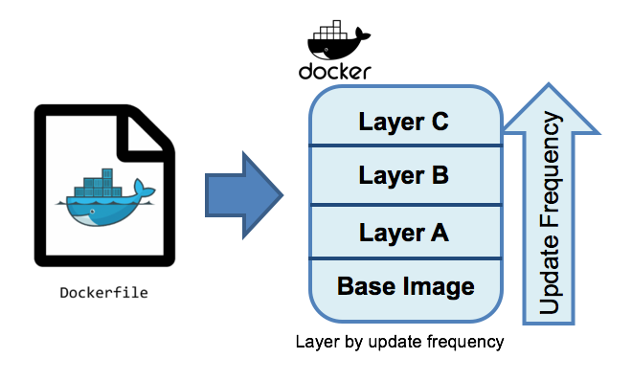
Docker build
Notes:
Instructor notes:
Docker build is a process which is used to create custom Docker image using Dockerfile. Using this Dockerfile we can perform various modifications on top of Base Docker image. We can use docker build command to execute Dockerfile and create custom Docker image. Below is the syntax for running Docker image.
We use Dockerfile to build custom docker images. This process can be done manually or using Jenkins CI CD pipelines. Use below command to build docker image
docker build –t <image_name>:<tag> .
Example: docker build –t dockerimage .

Slide 41
Publishing to Docker Hub
Docker hub is default repository interface integrated with Docker installation which is used to share images between different users.
Using Docker hub we can build Docker image on one system and deploy it on another system.
All base OS images and custom software's images are available in Docker hub and we can easily pull those on any server.
To push a repository to the Docker Hub, you must name your local image using your Docker Hub username, and the repository name that you created through Docker Hub on the web.
We can use set of commands involved in pushing and pulling Docker images:
docker push: To push Docker image to Docker hub
docker pull: To pull Docker image from Docker hub
docker tag: To create a different tag of an existing image for pushing to Docker hub
Notes:
Instructor notes:
Docker hub is default repository interface integrated with Docker installation which is used to share images between different users.
Using Docker hub we can build Docker image on one system and deploy it on another system.
All base OS images and custom software's images are available in Docker hub and we can easily pull those on any server.
To push a repository to the Docker Hub, you must name your local image using your Docker Hub username, and the repository name that you created through Docker Hub on the web.
We can use set of commands involved in pushing and pulling Docker images:
docker push: To push Docker image to Docker hub
docker pull: To pull Docker image from Docker hub
docker tag: To create a different tag of an existing image for pushing to Docker hub

Slide 42
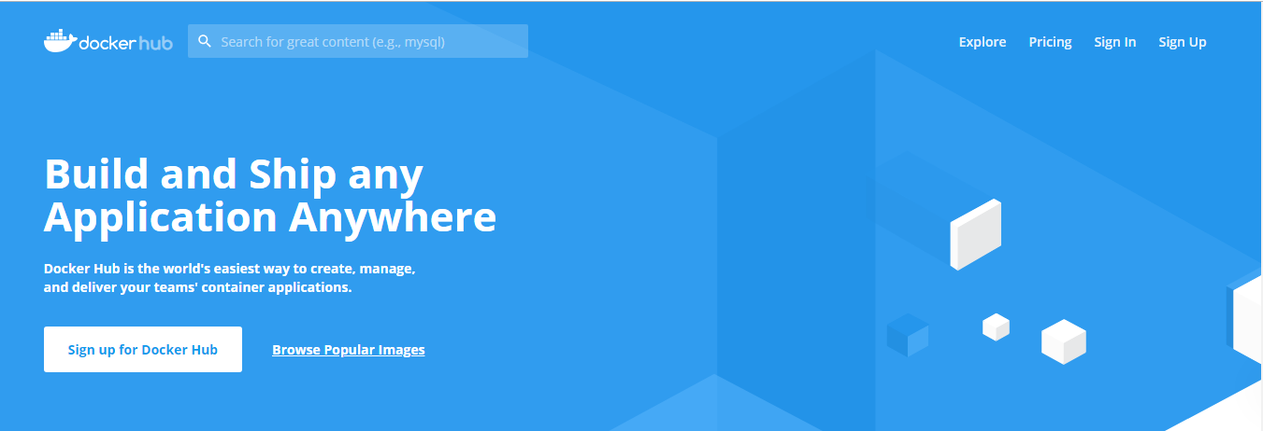
Publishing to Docker Hub
Docker hub account can be easily created using below link.
https://hub.docker.com/
Once account is created login to Docker hub and create your private/public repository.
Notes:
Instructor notes:
Docker hub account can be easily created using below link.
https://hub.docker.com/
Once account is created login to Docker hub and create your private/public repository.

Slide 43
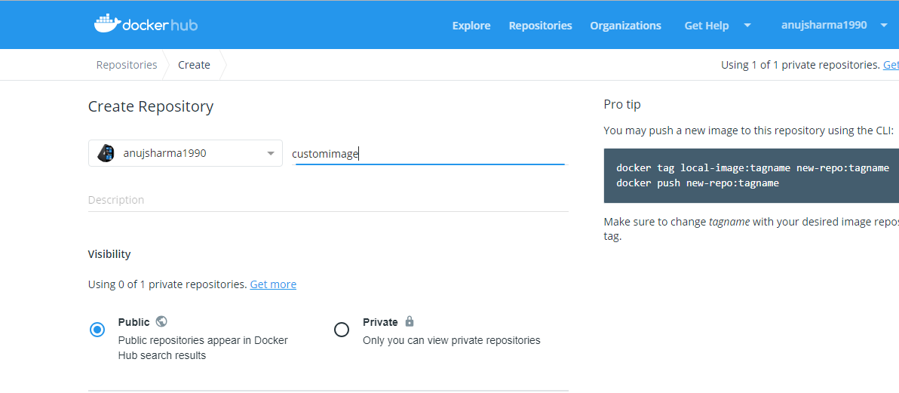
Publishing to Docker Hub
We can provide repository name and visibility to create a new repository in Docker hub which can be used to push Docker images different versions.
Notes:
Instructor notes:
We can provide repository name and visibility to create a new repository in Docker hub which can be used to push Docker images different versions.

Slide 44
Publishing to Docker Hub
Once repo is created we need to rename existing image according to this Docker hub repository name.
Use below commands to create a different tag with repo name.
docker tag local-image:tagname reponame:tagname docker push reponame:tagname
local-image Name of the Docker image which we want to modify
reponame Name of the repository created in Docker hub
In order to push Docker image to Docker hub we need to login to save credentials.
docker login Command to save credentials used to push Docker image from local to Docker hub
Notes:
Instructor notes:
Once repo is created we need to rename existing image according to this Docker hub repository name.
Use below commands to create a different tag with repo name.
docker tag local-image:tagname reponame:tagname docker push reponame:tagname
local-image Name of the Docker image which we want to modify
reponame Name of the repository created in Docker hub
In order to push Docker image to Docker hub we need to login to save credentials.
docker login Command to save credentails used to push Docker image from local to Docker hub

Slide 45
Binding containers with host/port
Docker containers by default can connect to outside world, but we will not be able to reach out to them from outside server.
We may have to expose our docker containers to outside world so that we can access applications deployed inside containers.
We can use –P flag with docker run command to expose all ports built up in docker image.
In case we want to expose only a specific port we can do that with –p flag.
Notes:
Instructor notes:
We can map ports between host and containers so that we can access applications deployed inside containers easily from outside world. We can use –P and –p flags with docker run command to expose ports of a docker container. Below is some of the exmaples for exposing ports.
docker run -p 80:80 nginx Exposes only 80 port of host machine with 80 port of container.
docker run -P nginx Exposes all ports which is exposed by Dockerfile suring docker build.

Slide 46
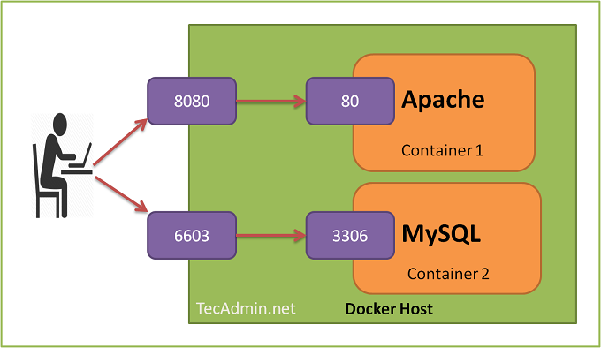
Binding containers with host/port
Notes:
Instructor notes:
As per above screenshot we could see that host machine ports are mapped with containers port so that we can access applications deployed inside containers from outside world.
By default docker exposes container to 0.0.0.0 host IP but we can configure that according to our requirement as per below:
docker run -p 10.0.0.3:80:80 nginx Where 10.0.0.3 is the IP on which we want to expose container

Slide 47
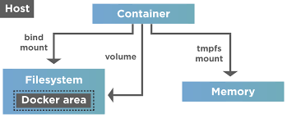
Filesystem in Containers
Notes:
Instructor notes:
When we work with docker container, if we removes container data doesn’t persist on server and we will be not be able to access that data. A container’s writable layer is tightly coupled to the host machine where the container is running.
We need storage driver to do modifications to this writable layer of docker container. The storage driver controls how images and containers are stored and managed on your Docker host.

Slide 48
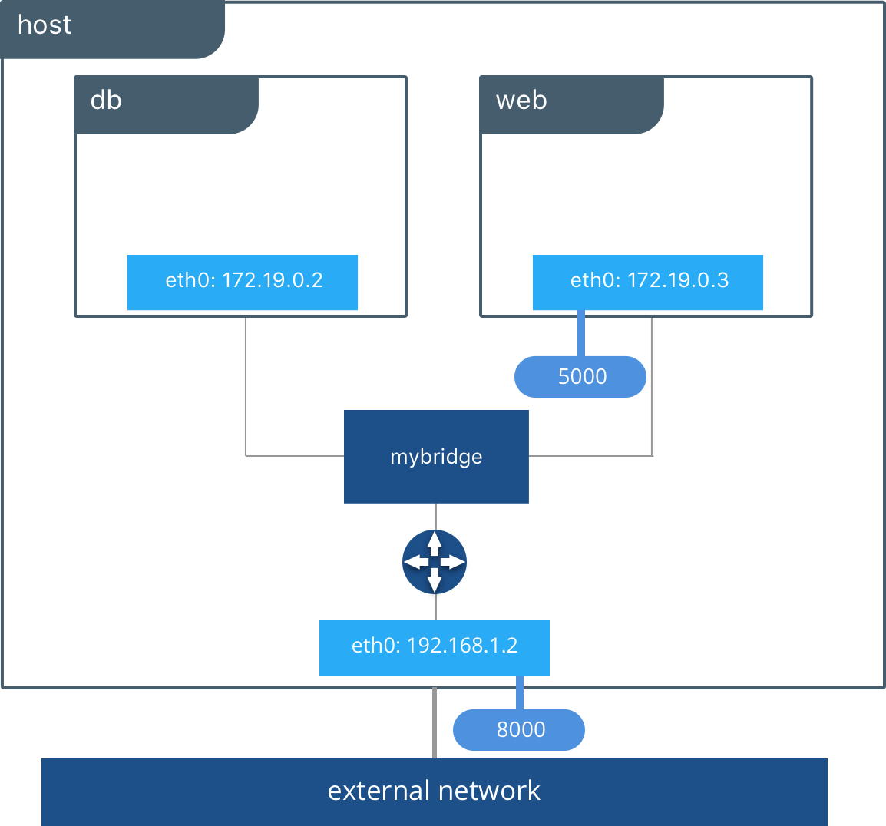
Docker Network
Notes:
Instructor notes:
When we deploy containers, they work totally isolated from each other. Docker network is a mechanism which helps containers to interact with other containers on host.
If we run ifconfig command on server, it will display docker network configured on server. As per above diagram we could see two containers deployed one for DB and another for web which interacts with each other using docker network.

Slide 49
Docker Network Types
There are mainly three types of docker networks which can be attached to docker container.
Depending on docker network, we will be able to interact with docker container accordingly.
Docker mainly supports four types of network drivers listed as below:
Bridge
Host
Null
Notes:
Instructor notes:
Below are some of the network drivers used by docker:
Bridge: Bridge is default network driver for docker. Its internal network created by docker on host server. This network is needed when containers need to communicate.
Host: This driver removes network isolation between docker containers and host. With this, docker containers will access host machine’s network.
Null: In this we don’t attach any network to docker containers which makes containers in accessible to external network or other containers.

Slide 50
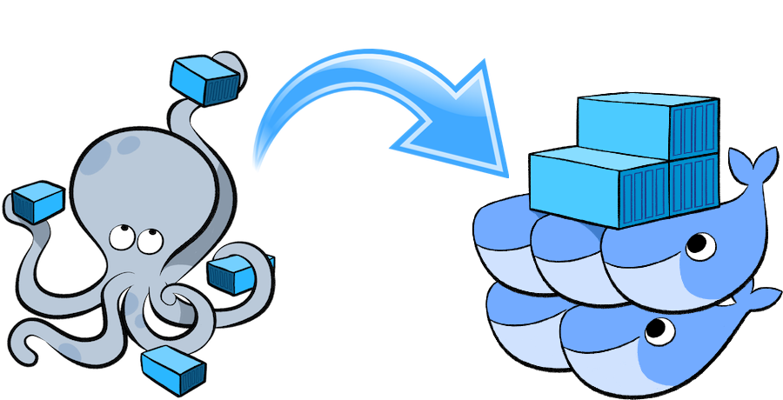
Docker Compose
Source: Docker
Notes:
Instructor notes:
Compose is a tool for defining and running multi-container Docker applications. Compose uses a YAML format file in which we configure all our application services.
Docker compose command is used then to build and create containers from this compose file. With compose we can run multiple containers with single command and same command can be used to stop multiple containers.
Some complex configuration like LAMP installation can be easily done with single file having all services configured together. Using Docker compose we can build containers and these containers can be linked also so that they can communicate with each other.
docker-compose.yml is the default file in which we can define our services configurations.

Slide 51
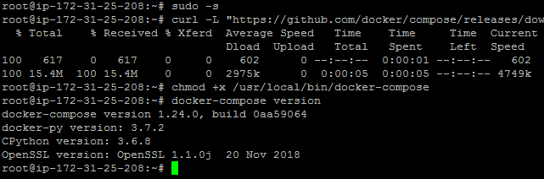
Docker Compose Setup
Notes:
Instructor notes:
Docker compose can be installed on MacOS, Linux and Windows platforms.
Below are the steps to install compose on Linux platform.
$ sudo –s
$ curl -L "https://github.com/docker/compose/releases/download/1.24.0/docker-compose-$(uname -s)-$(uname -m)" -o /usr/local/bin/docker-compose
$ chmod +x /usr/local/bin/docker-compose
$ docker-compose version

Slide 52
Docker Compose Example
version: '3.3'
services:
digitalone-db:
image: mysql:5.7
restart: always
environment:
MYSQL_DATABASE: 'db'
MYSQL_USER: 'user'
MYSQL_PASSWORD: 'password'
MYSQL_ROOT_PASSWORD: 'password'
ports:
- '3306:3306'
volumes:
- digitalone-volume:/var/lib/mysql
volumes:
digitalone-volume:
Notes:
Instructor notes:
Above is example docker compose file which is used to create a MySQL docker container and store container data in docker volume.

Slide 53
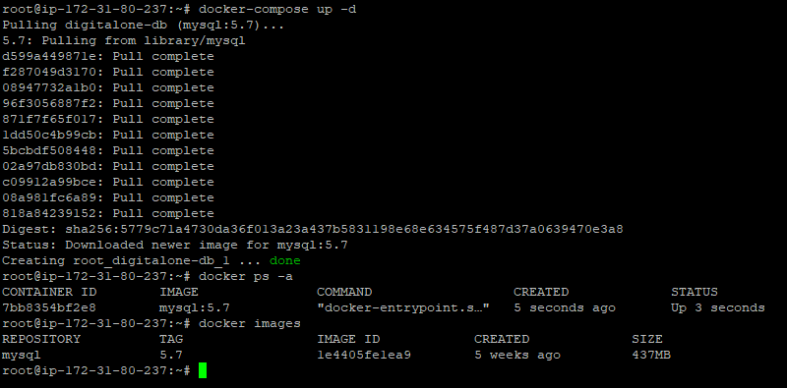
Docker Compose Commands
Notes:
Instructor notes:
Once docker compose is installed, create docker-compose.yml file which will be used to create multiple resources like containers, volumes, networks using compose file.
Below are some of the commands to interact with docker compose file.
docker-compose build To build all images configured as part of docker compose file.
docker-compose up -d This will run all docker containers as per docker compose file.
docker-compose down This will delete all docker containers and resources configured in compose file.

Slide 54
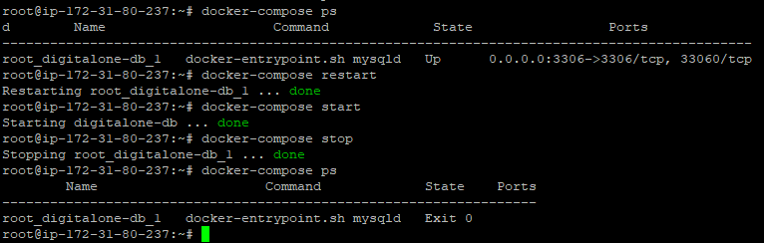
Docker Compose Commands
Notes:
We can even delete resources created by compose file using docker-compose down command. In case we need to restart containers deployed using compose file we can run below commands to bounce applications inside containers deployed using compose file.
docker-compose ps To see all containers running on docker host
docker-compose restart To restart all containers
docker-compose stop To stop all containers
docker-compose start To start all containers

Slide 55
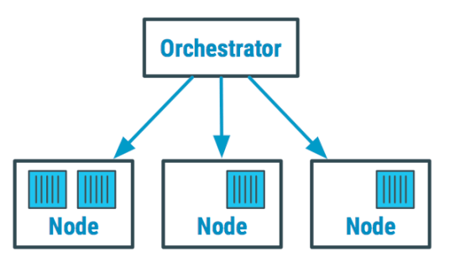
Docker Containers Orchestration
Notes:
Instructor notes:
Container orchestration is a process of managing the lifecycle of containers in large scale environments. These tools are used by operation teams to manage multiple applications containers and automate containers deployments.
We can also use these tools in CI CD workflow of Docker containers. There are two major orchestration tools available for Docker i.e. Kubernetes and Docker Swarm.
We can also scale our containers up and down depending on our requirement using these orchestration tools.
These orchestration tools also provides the features like load balancing and failover. These tools helps to check the health of containers inside the cluster and there respective hosts.

Slide 56
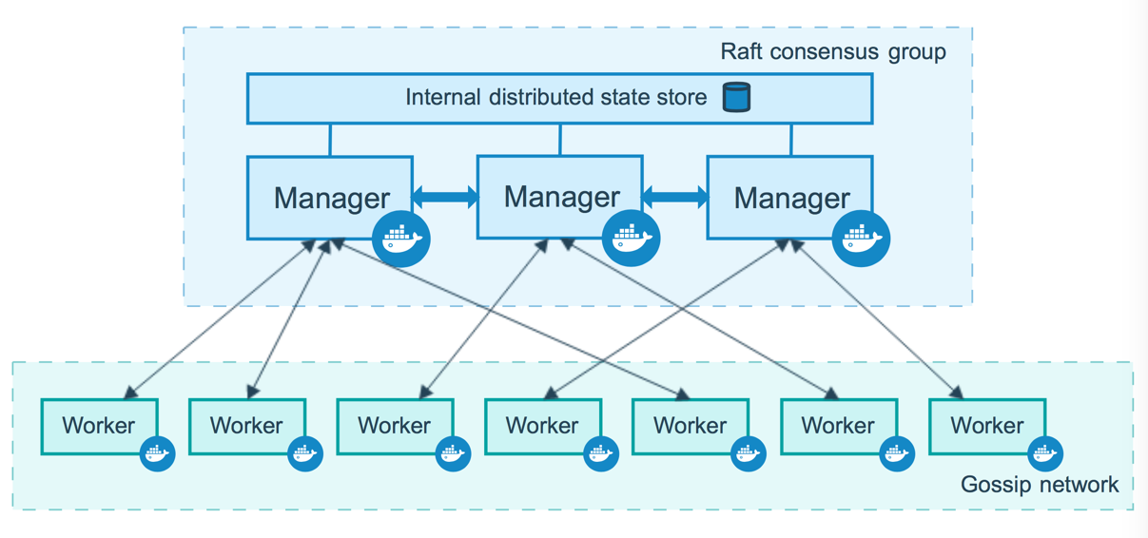
Docker Swarm
Source: Docker
Notes:
Docker Swarm is a open source tool that provides features like container orchestration, clustering and scheduling of containers.
With Docker swarm we can deploy containers to multiple nodes machine without connecting to any of them. It uses Master Slave architecture in which we should have at least one Swarm manager and all other nodes are considered as worker nodes.
Swarm manager sends the request to worker nodes, worker nodes does all the work in scheduling containers.

Slide 57
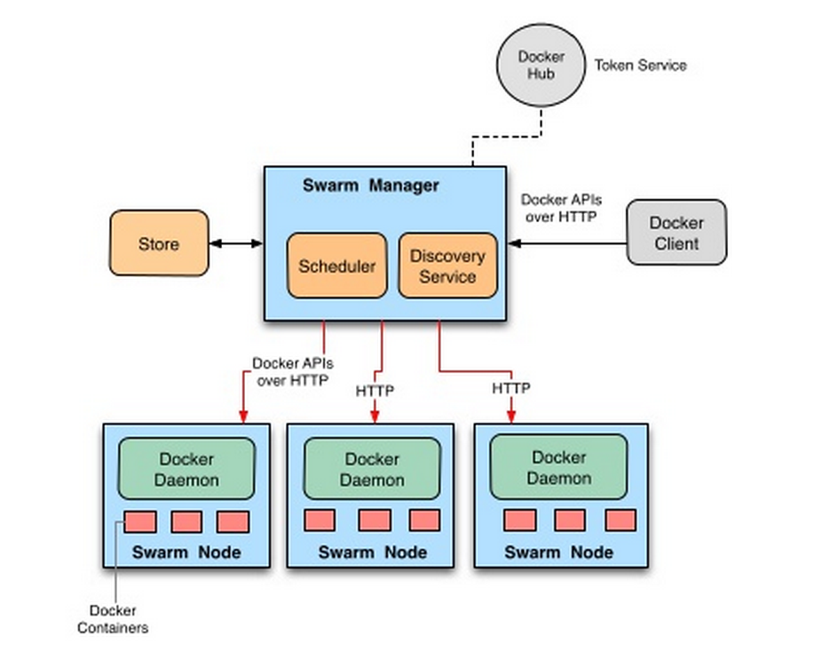
Docker Swarm Features
Docker swarm supports lot of features which we get with orchestration deployment. Some of them are listed below:
Scaling
Multi node cluster
Service discovery
Load Balancing
Notes:
Instructor notes:
Below are some of the features supported by swarm orchestration tool:
Scaling: By default as part of service deployment only one container gets created, but we can scale it to a numeric value. We can declare the number of tasks we want to run, for each service.
Multi node cluster: Swarm supports multiple node which can be configured in swarm cluster. This will help to deploy containers across multiple nodes without deploying containers manually.
Service discovery: Swarm manager assigns unique DNS name and port to each container deployed on swarm cluster. Using this DNS name we could connect to application deployed inside this container.
Load Balancing: We can deploy multiple instances of container inside a service, which means swarm service will be sharing load across different containers and nodes.

Slide 58
Docker Swarm Advantages
Below are some of the benefits which we get with swarm implementation:
Docker swarm is tightly integrated with Docker ecosystem, and implements Docker API.
Since developed by Docker itself, Docker swarm gets smoothly integrated with Docker.
Swarm is less expensive as compared to any other container orchestration tool.
Swarm supports low fault tolerance feature as compared to Kubernetes.
Docker swarm has low learning curve which means swarm is easy to learn without any complexity.
Notes:
Instructor notes:
Below are some of the benefits which we get with swarm implementation:
Docker swarm is tightly integrated with Docker ecosystem, and implements Docker API. Since developed by Docker itself, Docker swarm gets smoothly integrated with Docker.
Swarm is less expensive as compared to any other container orchestration tool. Swarm supports low fault tolerance feature as compared to Kubernetes.
Swarm supports low fault tolerance feature as compared to Kubernetes. Docker swarm has low learning curve which means swarm is easy to learn without any complexity.

Slide 59
Docker Swarm Disadvantages
Although Docker swarm provides some advantages but still there are some disadvantages with swarm cluster:
Docker Swarm provides limited functionality.
Docker Swarm has limited fault tolerance.
Docker Swarm have smaller community as compared to Kubernetes community.
In Docker Swarm, services can only be scaled manually, we don’t have any autoscaling feature with Docker swarm.
Notes:
Instructor notes:
Although Docker swarm provides some advantages but still there are some disadvantages with swarm cluster:
Docker Swarm provides limited functionality.
Docker Swarm has limited fault tolerance.
Docker Swarm have smaller community as compared to Kubernetes community.
In Docker Swarm, services can only be scaled manually, we don’t have any autoscaling feature with Docker swarm.

Slide 60
Docker Swarm Nodes
Docker Swarm architecture comprises of various machines and some of them are listed as below:
Manager Node
Leader Node
Worker Node
Notes:
Instructor notes:
Docker Swarm architecture comprises of various machines and some of them are listed as below:
Manager Node: Manager node primarily task is to mange workloads across swarm cluster. It assigns tasks to worker nodes in the swarm. In docker swarm we can only add maximum 7 manager nodes.
Leader Node: In a swarm cluster we can have multiple leaders, who is responsible for doing all administrative tasks. In case one leader is down another leader will take place and continue the work.
Worker Node: We can have multiple worker nodes in a cluster, which are used to execute tasks and host containers on them. Manager node interacts with these worker nodes and in case another worker node is down, task will be deployed on another worker node.

Slide 61
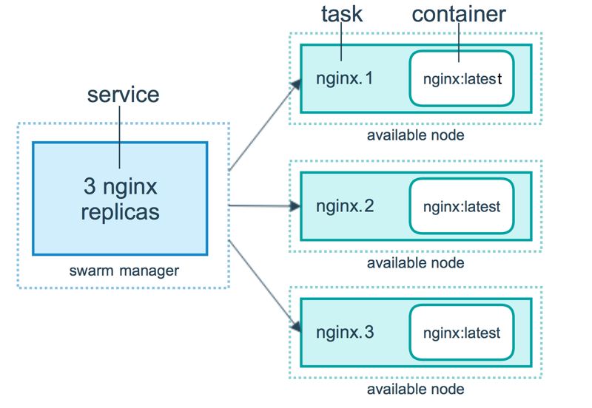
Docker Service
Notes:
Instructor notes:
When you deploy the service to the swarm, the swarm manager accepts your service definition as the desired state for the service. Then it schedules the service on nodes in the swarm as one or more replica tasks. The tasks run independently of each other on nodes in the swarm.

Slide 62
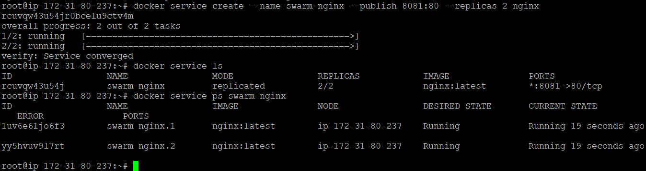
Docker Service Setup
Notes:
Instructor notes:
Once swarm cluster is ready, we can quickly deploy one Nginx service on swarm using below docker service command.
docker service create --name swarm-nginx --publish 8081:80 --replicas 2 nginx
In above command we are exposing Nginx service on 8081 port on host machine. We can verify docker container for this service using below command.
docker service ps swarm-nginx

Slide 63
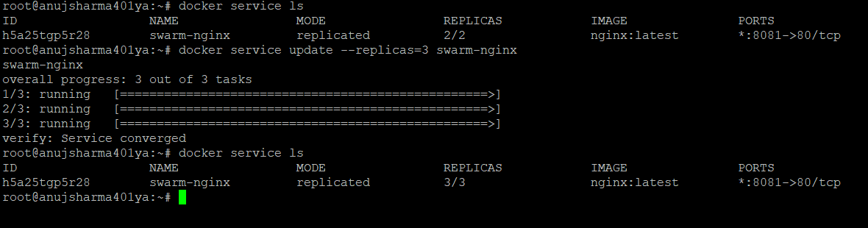
Docker Service Update
Notes:
Instructor notes:
updating a service will only cause the service’s tasks to be replaced with new ones if a change to the service requires recreating the tasks for it to take effect. Using docker service update command, user can update existing configuration of Docker Swarm services.
Example: This command is going to increase number of replicas for Nginx docker container.
docker service update --replicas=3 swarm-nginx

Slide 64
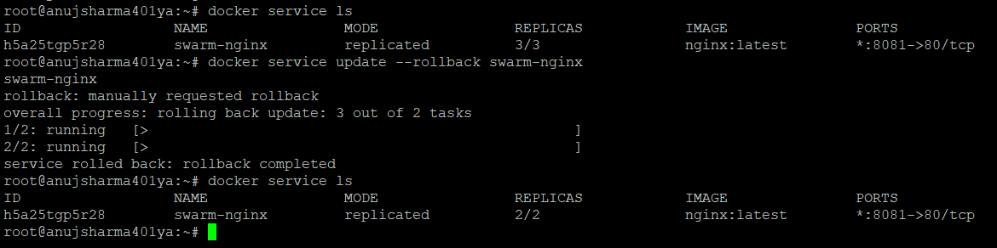
Docker Service Update Rollback
Notes:
Instructor notes:
Use the --rollback option to roll back to the previous version of the service.
This will revert the service to the configuration that was in place before the most recent docker service update command.
Example: This command is going to rollback previous updates done to service.
docker service update --rollback swarm-nginx

